Slide 1
Introduction to Cloud Computing

Slide 2
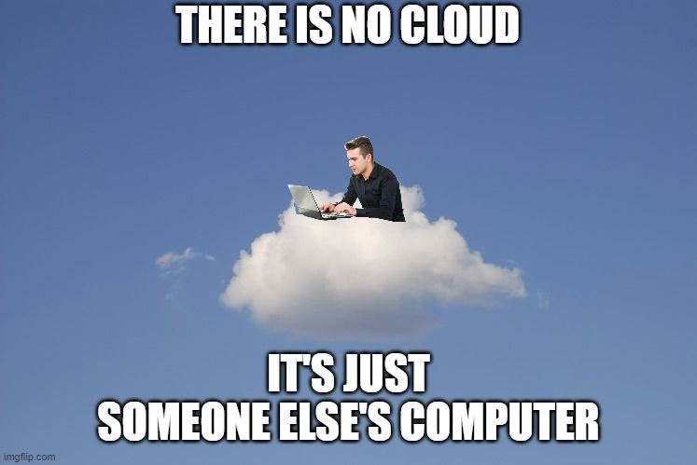
What is Cloud Computing?
Store, manage & access data online
No physical servers needed
Like renting IT resources

Slide 3
Why Use Cloud?
Pay only for what you use
Scale up/down easily
Access anywhere, anytime

Slide 4
Types of Cloud
Public: Shared for everyone (Azure, AWS)
Private: Dedicated to one company
Hybrid: Best of both worlds

Slide 5
Service Models
IaaS: Rent infrastructure (VMs)
PaaS: Build without managing servers
SaaS: Ready-made apps (Gmail, Netflix)

Slide 6
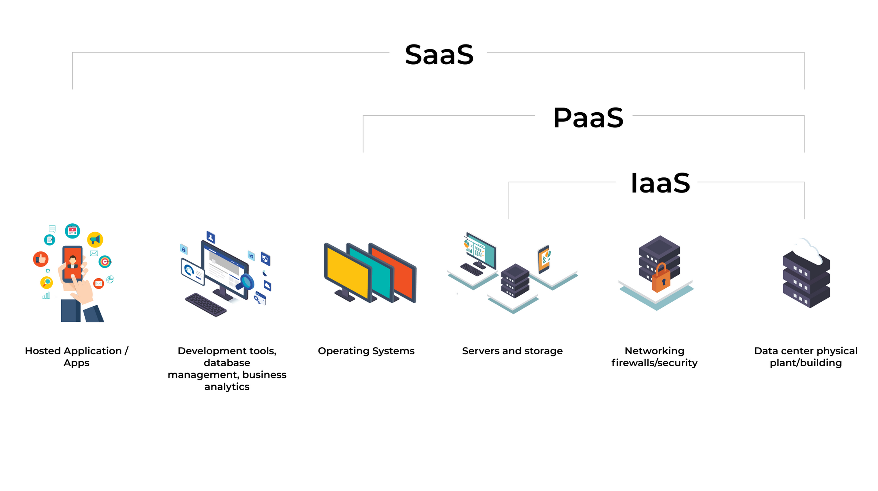

Slide 7
Where Do You Already Use the Cloud?

Slide 8



Where Do You Already Use the Cloud?

Slide 9
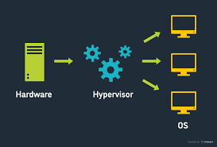
Virtualization Intro
One server → Many virtual machines
Saves cost & resources
Foundation of cloud computing

Slide 10
Introduction to Azure
Microsoft’s cloud platform
Offers Compute, Storage, Networking
Free tier for students

Slide 11
Real-World Uses
Startups launch apps fast
Enterprises secure hybrid setups
Personal backups & sharing

Slide 12
Recap & Q/A
Cloud = Rent computing via the internet
Types: Public, Private, Hybrid
Models: IaaS, PaaS, SaaS

